Slide 1
IRG-AVQA (Intersector Rapporteur Group Audiovisual Quality Assessment)
December 19, 2023
Online

Slide 2
The IRG-AVQA studies topics related to video and audiovisual quality assessment among ITU-R SG6 and ITU-T SG12. The IRG-AVQA aims to:
coord​inate the progress of specific topics of mutual interest restricted to the area of video and audiovisual quality assessment, both subjective and objective;
identify potential work items that may be progressed as joint text Recommendations;
benefit from colocation with the meetings of the Video Quality Experts Group (VQEG)​​ where video/audiovisual quality experts meet and execute technical work;
encourage collaboration between ITU-T SG12 and ITU-R SG6 on work items unique to each study group.

Slide 3
The IRG-AVQA allows rapporteurs to:
exchange information faster, using email and joint meetings;
seek participation from a broader range of ITU members;
invite input from non-member experts (e.g., from academia);
keep people informed at the early stage of work;
set up a joint edit session on a Recommendation;
socialize work items that approach maturity;
Participants who can contribute technology proposals are invited and encouraged to join the group.
https://www.itu.int/en/irg/avqa/Pages/default.aspx

Slide 4
Co-Chairs
Chulhee Lee(Korea, Rep of)
Alexander Raake (Germany)

Slide 5
ITU-R WP6C

Slide 6
Current Work Items (Video)
Preliminary draft revision of Recommendation ITU-R BT.1662 - General reference chain and management of post-processing headroom for programme essence in large screen digital imagery applications
Preliminary draft revision of Recommendation ITU-R BT.1666 - User requirements for large screen digital imagery applications intended for presentation in a theatrical environment

Slide 7
Current Work Items (HDR)
WD preliminary draft revision of Recommendation ITU-R BT.2100-2 - Image parameter values for high dynamic range television for use in production and international programme exchange
WD preliminary draft new Recommendation ITU-R BT.[REQ-MIL] - Requirements and applications for Image Level meters
WD a preliminary draft new Recommendation ITU-R BT.[MON] - [Reference] viewing conditions for HDR and SDR monitoring in close proximity within a single-master broadcast production environment
WD a preliminary draft revision of Report ITU-R BT.2408 - Guidance for operational practices in HDR television production

Slide 8
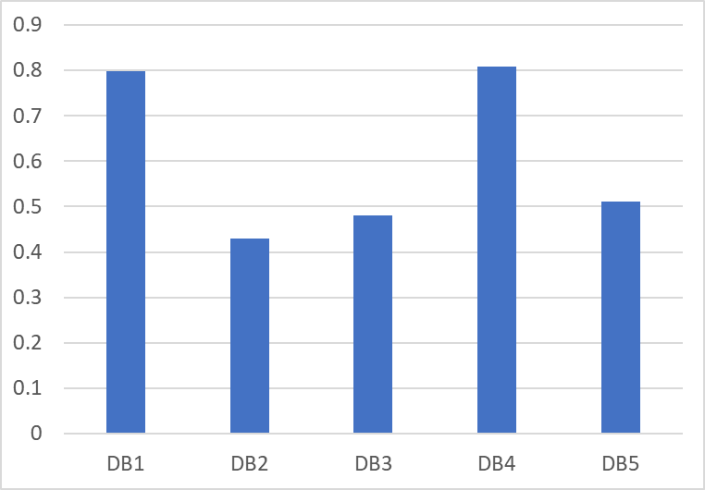
Deep-learning NR methods trained with large training samples

Slide 9
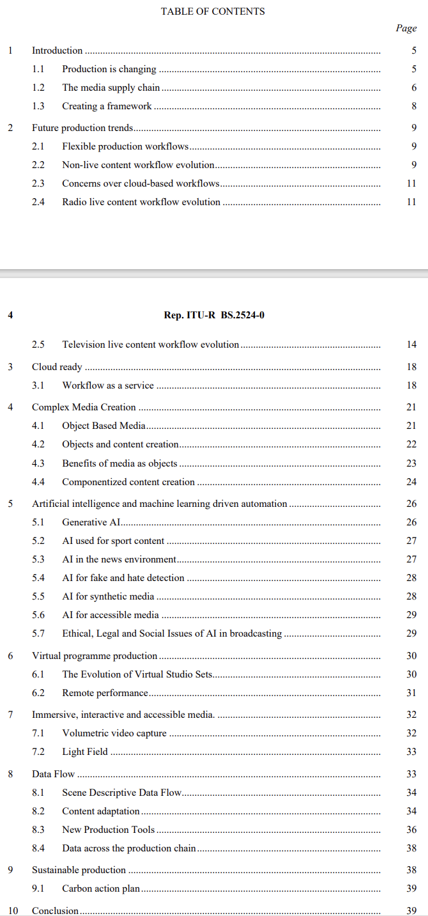
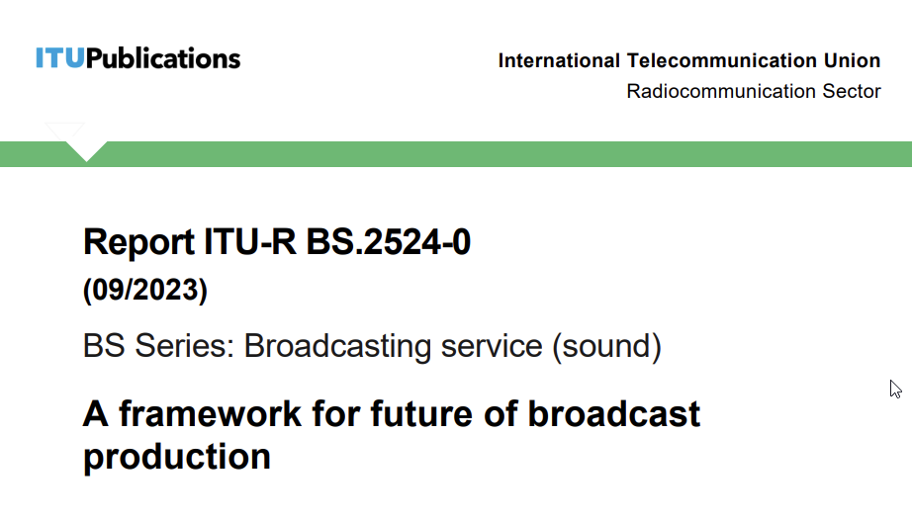
A Vision for the Future of Broadcasting

Slide 10
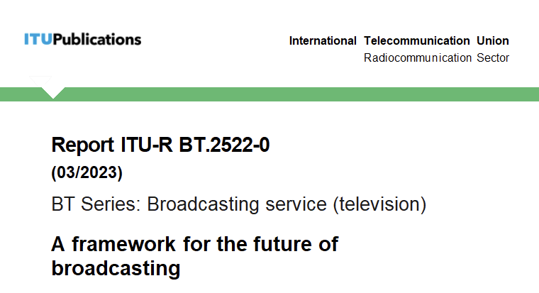
A Vision for the Future of Broadcasting

Slide 11
Table of Contents, BT.2522
1 Introduction
1.1 Timescale
1.2 Challenges and opportunities in future environments
2 Future user experience
2.1 User experience framework
2.2 Collective experience
2.3 Personalized user experience
2.4 Ubiquitous media consumption experience
2.5 Digital assistant and ambient computing ecosystem experiences
2.6 Accessible experiences
2.7 Immersive experiences
2.8 Experiences that merge the physical world and the digital world
3 Future of media production
3.1 Future production framework
3.2 Software-based production
3.3 Virtualized production
3.4 Cloud-based production
3.5 Complex media production
3.6 Data-driven production
3.7 Automated production through artificial intelligence and machine learning
3.8 Immersive and accessible media production
3.9 Sustainable production
4 Future broadcast delivery
4.1 Spectrum allocated to the broadcasting service
4.2 Global platform
4.3 Integrated broadcast-broadband systems
4.4 Future delivery trends
4.5 User-driven trends for new delivery services
4.6 Infrastructure changes needed for the adoption of new delivery systems
4.7 Coverage requirements of new delivery systems
5 Conclusion
5.1 Realizing the potential of the framework for the future of broadcasting.

Slide 12
ITU-T SG12

Slide 13
Some work items of ITU-T SG12 Question 7 Rapporteur: Ludovic MALFAIT
Methodologies, tools and test plans for the subjective assessment of speech, audio and audiovisual quality interactions
P.835ref Subjective test methodology for evaluating speech communication systems that include noise suppression algorithm
P.IntVR Subjective test method for interactive virtual reality applications
P.PHYSIO Use of physiological measures as an additional test method for speech quality assessment
PSTR.OUTLAB Conducting subjective tests outside of the lab

Slide 14
Some work items of ITU-T SG12 Question 9 Rapporteur: Jens Berger
Perceptual-based objective methods and corresponding evaluation guidelines for voice and audio quality measurements in telecommunication services
P. SAMD: Single-ended perceptual approaches for multi-dimensional analysis
P.TCA: Technical cause analysis

Slide 15
Some work items of ITU-T SG12 Question 13 Rapporteurs: Kazuhisa Yamagishi
Quality of experience (QoE), quality of service (QoS) and performance requirements and assessment methods for multimedia applications
P.SMAR: Subjective Tests for Evaluating the User Experience for Mobile AR Applications

Slide 16
Some work items of ITU-T SG12 Question 14 Rapporteurs: Jörgen Gustafsson, Alexander Raake
Development of models and tools for multimedia quality assessment of packet-based video services
P.1204.1 Extend P.1204 recommendations with support for new codecs
P.1204.2 Video quality assessment of streaming services over reliable transport for resolutions up to 4K with access to video frame information
P.BBQCG Parametric bitstream-based Quality Assessment of Cloud Gaming Services
P.MOSQUITO Subjective test methodology for assessing impact of adaptive streaming effects on longer-term Quality of Experience (MOS) and quitting (for objective model development)
P.NATS-Codec-Ext Parametric Non-intrusive Bitstream Assessment for High Efficiency Video Coding (HEVC) and 4K Media Streaming Quality over UDP
P.NATS-ph3 Quality integration module for adaptive video streaming QoE in the context of P.120X-Recommendation series
PSTR-OQMXR Objective quality modelling for XR services

Slide 17
P.1204.X Codec extension
P.1204.4 and P.1204.5 have been extended to AV1, cf. Recommendations
P.1204.3 is ongoing, to be finished Q1/2024
Further extensions desirable, e.g., VVC
New work items HDR, 8K, ...
collaboration VQEG?
P.NATS Phase 3 / P.MOSQUITO
Overarching integration module
Initial work stream including “quitting” not currently pursued
Collaboration Q14 & VQEG, e.g., AVHD? (following successful P.NATS Phase 2 work)

Slide 18
P.BBQCG - Parametric bitstream-based Quality Assessment of Cloud Gaming Services
“Active” and “passive” work streams
Regular sub-group meetings Mon 16-17 CET, Wed 14-15h CET
“Passive”
Tests mostly concluded, report and paper in preparatrion
“Active”
Currently work for pre-tests and initial tests underway. specifically addressing possible test environment candidates
Work group expands beyond typical Q14 collaborations, good collaborations with VQEG

Slide 19
PSTR-OQMXR Objective quality modelling for XR services
Still under specification
Rather wide landscape of solutions
Technology not as mature as for, e.g., video streaming
Links with Q10/12 (interactive services) and VQEG IMG
Request for interested parties from VQEG?

Slide 20
Some work items of ITU-T SG12 Question 19 Rapporteurs: Chulhee Lee
Objective and subjective methods for evaluating perceptual audiovisual quality in multimedia and television services
J.noref: Perceptual video quality measurement techniques for digital cable television in the absence of a reference
J.src-vq: Objective Assessment Methods for Source Video Quality at the Headend
J.q-uhd: Quality measurement methods for UHD services
P.obj-recog: Estimation techniques of object-recognition rate in surveillance video of autonomous driving

Slide 21
2024 ITU-R SG6 Meeting Schedule:
4-8 March 2024 (Geneva)
4-8 November 2024 (Geneva)
2024 ITU-T SG12 Meeting Schedule:
15-25 April 2024 (Geneva)

Slide 22
THE END

